Slide 1
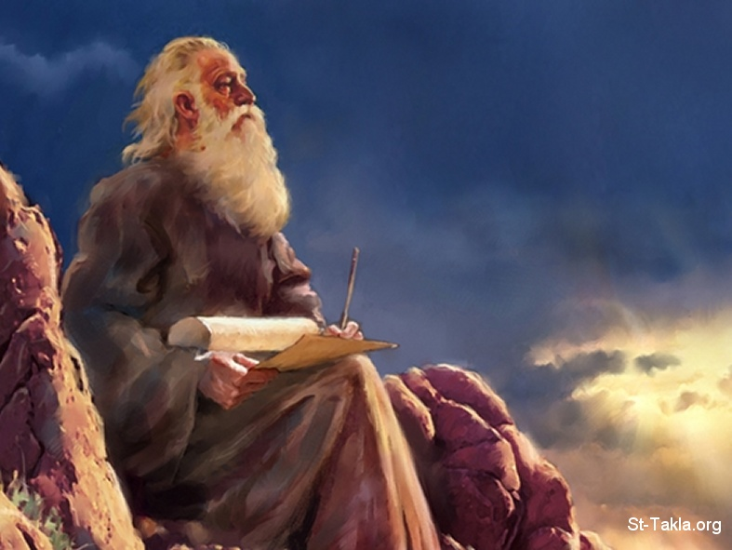

Slide 2
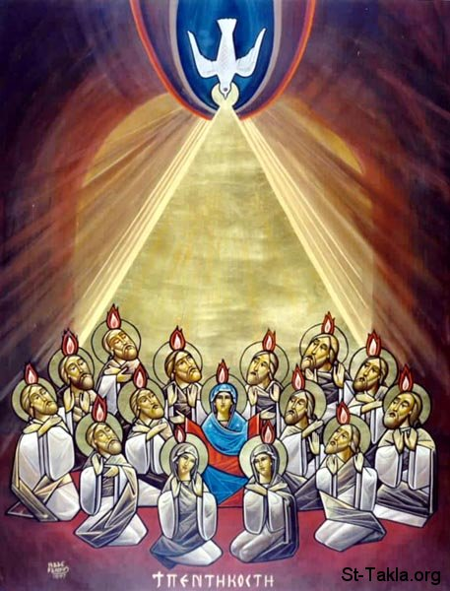

Slide 4
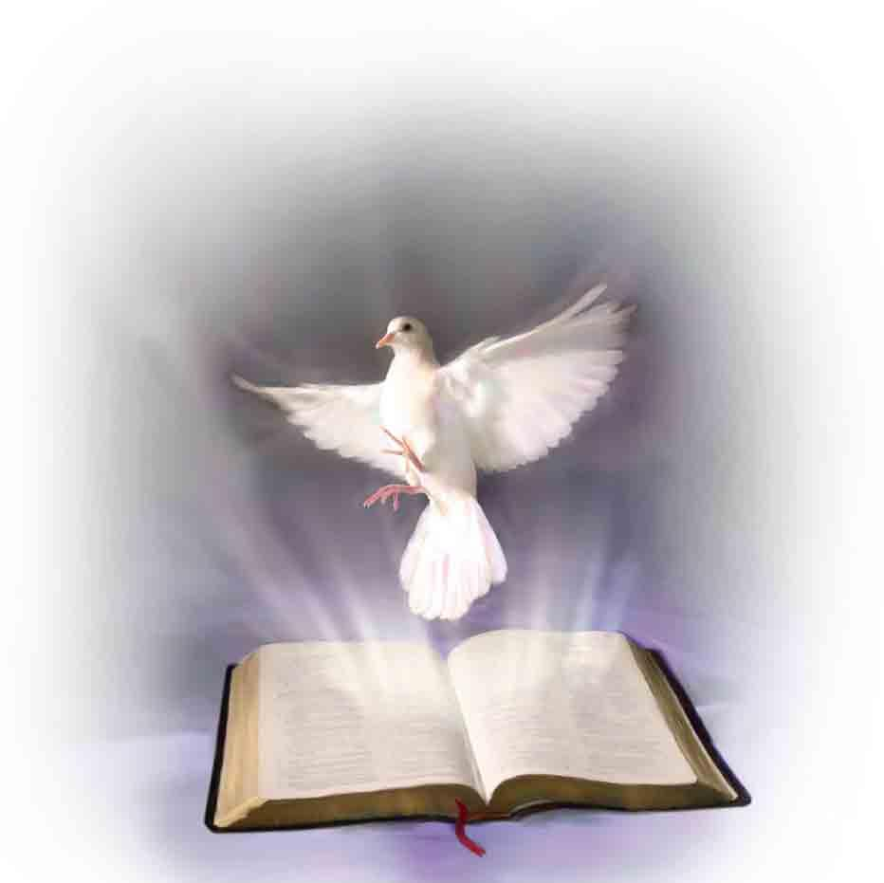

Slide 5
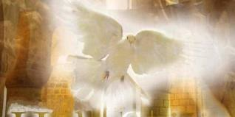

Slide 7
كيف؟؟!!
How??!!

Slide 8
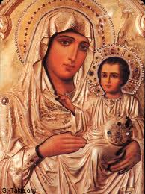
الله، بعد ما كلم الآباء بالأنبياء قديما، بأنواع وطرق كثيرة كلمنا في هذه الأيام الأخيرة في ابنه، الذي جعله وارثا لكل شيء، الذي به أيضا عمل العالمين (عب1:1-2)
God, who at various times and in various ways spoke in time past to the fathers by the prophets, has in these last days spoken to us by His Son, whom He has appointed heir of all things, through whom also He made the worlds (Heb1:1-2)

Slide 9
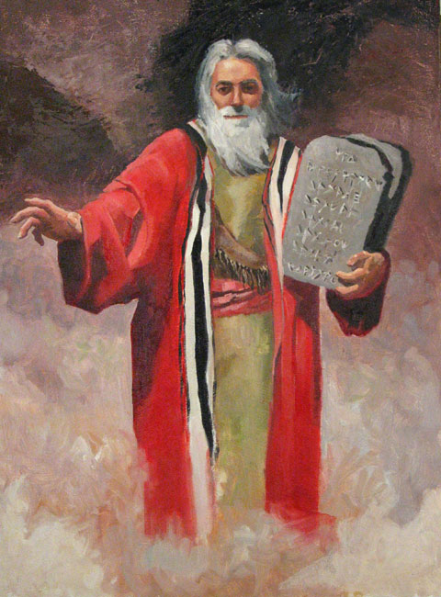
”فقال: اسمعا كلامي . إن كان منكم نبي للرب، فبالرؤيا أستعلن له. في الحلم أكلمه وأما عبدي موسى فليس هكذا، بل هو أمين في كل بيتي فما إلى فم وعيانا أتكلم معه، لا بالألغاز. وشبه الرب يعاين. فلماذا لا تخشيان أن تتكلما على عبدي موسى“ (عدد 12: 6-8)
Then He said, "Hear now My words: "If there is a prophet among you, I, the Lord, make Myself known to him in a vision; I speak to him in a dream. Not so with My servant Moses; He is faithful in all My house. I speak with him face to face, Even plainly, and not in dark sayings; And he sees the form of the Lord. Why then were you not afraid To speak against My servant Moses?” (Numbers 12: 6-8)

Slide 10
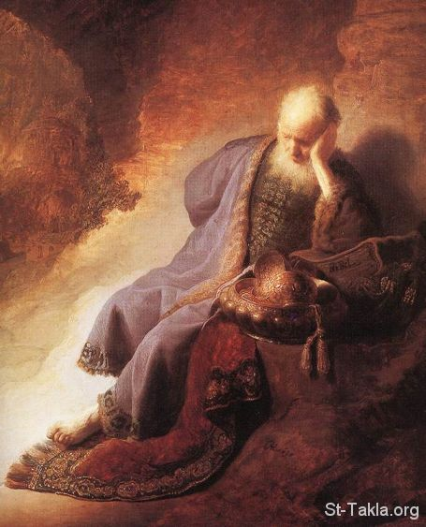
ومد الرب يده ولمس فمي، وقال الرب لي: ها قد جعلت كلامي في فمك
انظر قد وكلتك هذا اليوم على الشعوب وعلى الممالك، لتقلع وتهدم وتهلك وتنقض وتبني وتغرس ( أر1: 9-10)
Then the Lord put forth His hand and touched my mouth, and the Lord said to me: "Behold, I have put My words in your mouth. See, I have this day set you over the nations and over the kingdoms, To root out and to pull down, To destroy and to throw down, To build and to plant.“ (Jer 1:9-10)

Slide 11
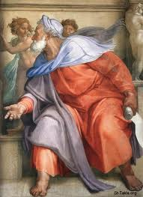
”فقال لي: يا ابن آدم، قم على قدميك فأتكلم معك فدخل في روح لما تكلم معي، وأقامني على قدمي فسمعت المتكلم معي وقال لي: يا ابن آدم، أنا مرسلك إلى بني إسرائيل، إلى أمة متمردة قد تمردت علي. هم وآباؤهم عصوا علي إلى ذات هذا اليوم“ (حز 2: 1-3)
And He said to me, "Son of man, stand on your feet, and I will speak to you." Then the Spirit entered me when He spoke to me, and set me on my feet; and I heard Him who spoke to me. And He said to me: "Son of man, I am sending you to the children of Israel, to a rebellious nation that has rebelled against Me; they and their fathers have transgressed against Me to this very day. (Ezek 2:1-3)

Slide 13
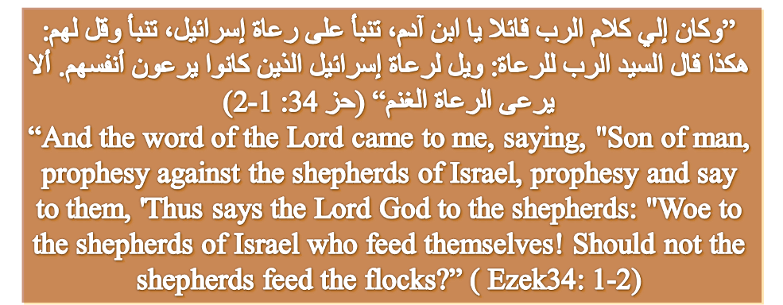

Slide 14
تراءى لي الرب من بعيد ومحبة أبدية أحببتك، من أجل ذلك أدمت لك الرحمة (أر 31:3)
The LORD has appeared of old to me, [saying:] "Yes, I have loved you with an everlasting love; Therefore with lovingkindness I have drawn you (Jer 31 : 3)

Slide 15
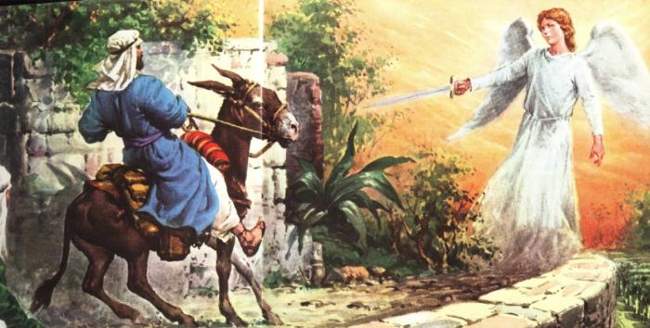

Slide 16
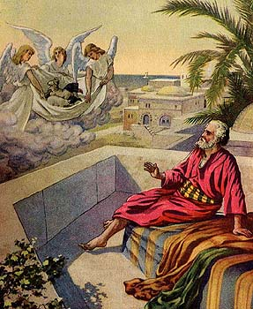

Slide 17
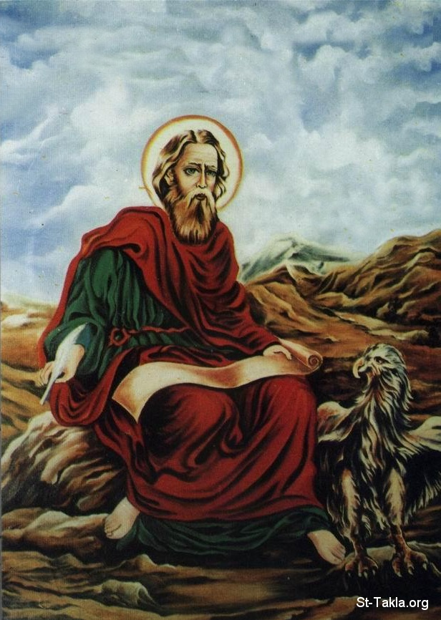

Slide 19
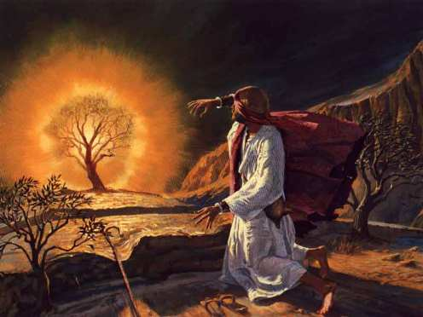

Slide 22
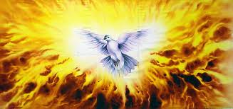

Slide 23
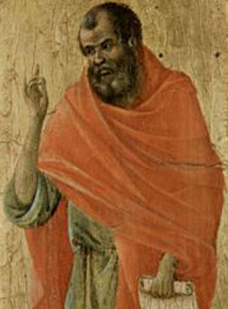

Slide 24
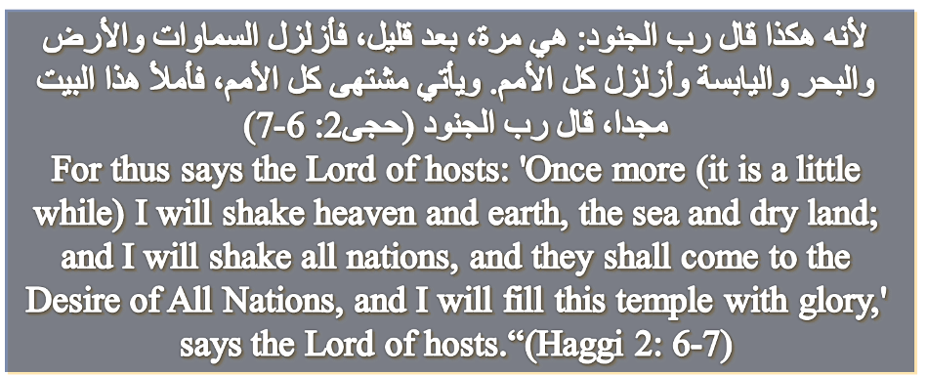

Slide 25
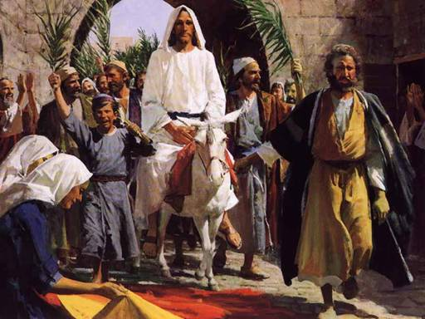

Slide 26
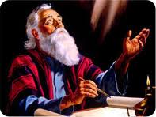

Slide 27
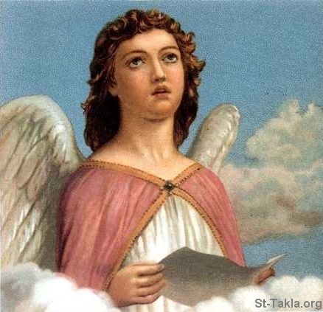
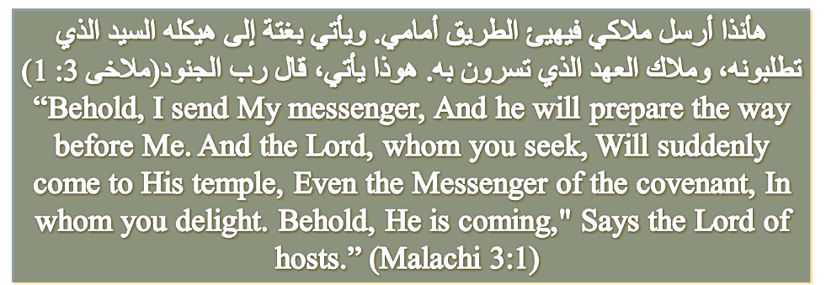

Slide 28
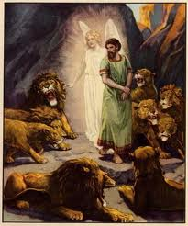

Slide 29
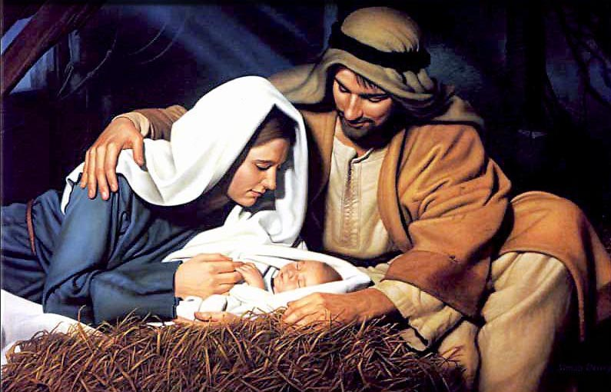

Slide 30
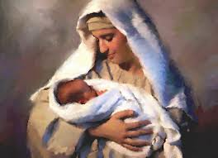

Slide 31
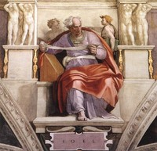

Slide 32
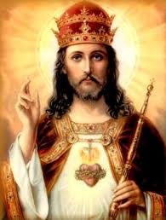
أنبياء يتمثلون بالمسيح
Prophets resembling Jesus Christ
يوسف.... من السجن إلى الملك
Joseph…..from prison to monarch
دانيال.....من الجب إلى المجد
Daniel…..from the den to glory
موسى..ابن الماء....من الموت للحياة
Moses…Son of water….from death to life

Slide 33
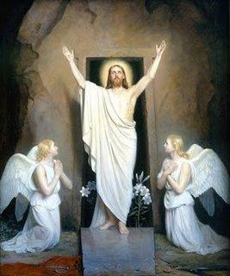
أنبياء يتمثلون بالمسيح
Prophets resembling Jesus Christ
اسحق.....يذبح...ليقوم
Isaac…slaughtered…to resurrect
يونان....من جوف الحوت للخلاص
Jonah….from being swallowed by the whale to salvation

Slide 34
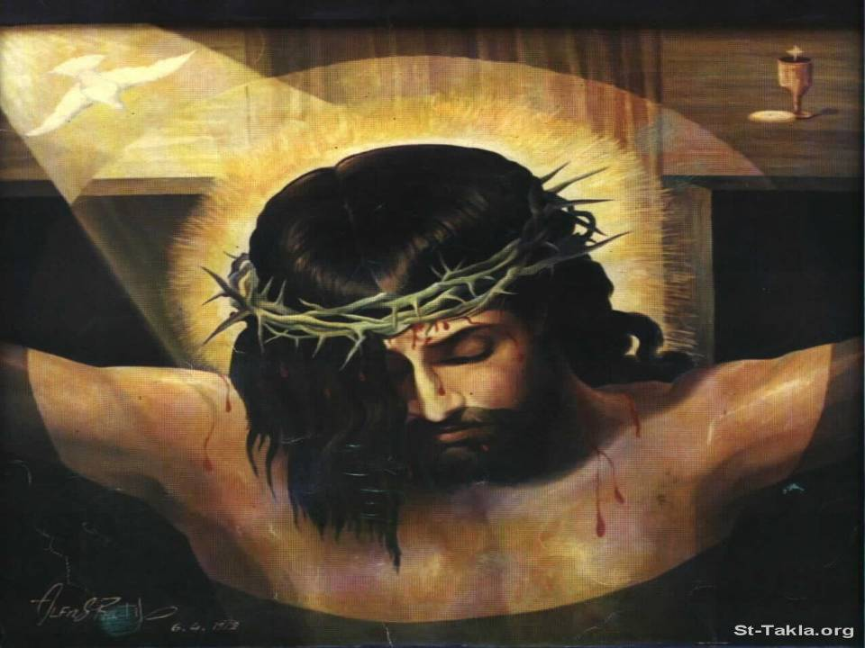
أنبياء يشعرون بألام المسيح
Prophets who felt Jesus Christ’s Pain

Slide 35
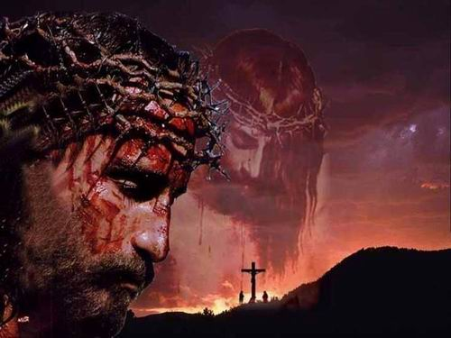
أبلى لحمي وجلدي . كسر عظامي
بنى علي وأحاطني بعلقم ومشقة (مراثى 3: 4-5)
He has aged my flesh and my skin, And broken my bones. He has besieged me And surrounded me with bitterness and woe.(Lam 3:4-5)

Slide 36
صرت ضحكة لكل شعبي، وأغنية لهم اليوم كله أشبعني مرائر وأرواني أفسنتينا وجرش بالحصى أسناني . كبسني بالرماد (مراثى3: 14-16)
I have become the ridicule of all my people-- Their taunting song all the day. He has filled me with bitterness, He has made me drink wormwood. He has also broken my teeth with gravel, And covered me with ashes. (Lam3: 14-16)

Slide 37
كل الذين يرونني يستهزئون بي. يفغرون الشفاه، وينغضون الرأس قائلين
اتكل على الرب فلينجه، لينقذه لأنه سر به (مز22: 7-8)
All those who see Me ridicule Me; They shoot out the lip, they shake the head, saying, "He trusted in the Lord, let Him rescue Him; Let Him deliver Him, since He delights in Him!”(Psalm22: 7-8)

Slide 38
”كالماء انسكبت. انفصلت كل عظامي. صار قلبي كالشمع. قد ذاب في وسط أمعائي يبست مثل شقفة قوتي ، ولصق لساني بحنكي، وإلى تراب الموت تضعني لأنه قد أحاطت بي كلاب. جماعة من الأشرار اكتنفتني. ثقبوا يدي ورجلي أحصي كل عظامي، وهم ينظرون ويتفرسون في يقسمون ثيابي بينهم ، وعلى لباسي يقترعون (مز22: 14-18)
I am poured out like water, And all My bones are out of joint; My heart is like wax; It has melted within Me. My strength is dried up like a potsherd, And My tongue clings to My jaws; You have brought Me to the dust of death. For dogs have surrounded Me; The congregation of the wicked has enclosed Me. They pierced My hands and My feet; I can count all My bones. They look and stare at Me. They divide My garments among them, And for My clothing they cast lots. (Psalm22: 14-18)

Slide 39
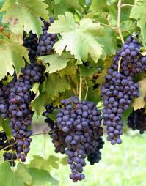
” رعاة كثيرون أفسدوا كرمي، داسوا نصيبي. جعلوا نصيبي المشتهى برية خربة جعلوه خرابا ينوح علي وهو خرب. خربت كل الأرض، لأنه لا أحد يضع في قلبه (أر12: 10-11)
Many rulers have destroyed My vineyard, They have trodden My portion underfoot; They have made My pleasant portion a desolate wilderness. They have made it desolate; Desolate, it mourns to Me; The whole land is made desolate, Because no one takes it to heart.(Jer12: 10-11)

Slide 40
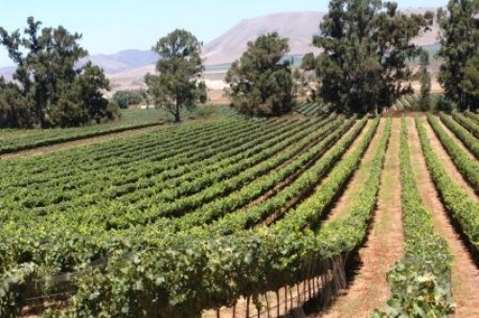
” لأنشدن عن حبيبي نشيد محبي لكرمه: كان لحبيبي كرم على أكمة خصبة فنقبه ونقى حجارته وغرسه كرم سورق، وبنى برجا في وسطه، ونقر فيه أيضا معصرة،
Now let me sing to my Well-beloved A song of my Beloved regarding His vineyard: My Well-beloved has a vineyard On a very fruitful hill. He dug it up and cleared out its stones, And planted it with the choicest vine. He built a tower in its midst, And also made a winepress in it;

Slide 41
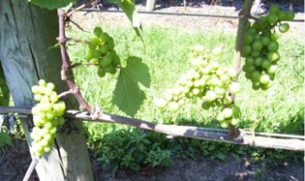
فانتظر أن يصنع عنبا فصنع عنبا رديئا والآن يا سكان أورشليم ورجال يهوذا، احكموا بيني وبين كرمي ماذا يصنع أيضا لكرمي وأنا لم أصنعه له ؟ لماذا إذ انتظرت أن يصنع عنبا، صنع عنبا رديئا(إش 5: 1-4)
So He expected it to bring forth good grapes, But it brought forth wild grapes. And now, O inhabitants of Jerusalem and men of Judah, Judge, please, between Me and My vineyard. What more could have been done to My vineyard That I have not done in it? Why then, when I expected it to bring forth good grapes, Did it bring forth wild grapes? (Isa5: 1-4)

Slide 42
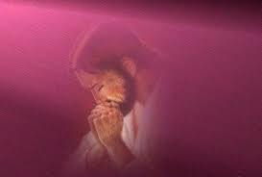
لأني من أجلك احتملت العار. غطى الخجل وجهى صرت أجنبيا عند إخوتي، وغريبا عند بني أمي لأن غيرة بيتك أكلتني، وتعييرات معيريك وقعت علي
(مز 69: 7-9)
Because for Your sake I have borne reproach; Shame has covered my face. I have become a stranger to my brothers, And an alien to my mother's children; Because zeal for Your house has eaten me up, And the reproaches of those who reproach You have fallen on me. (Psalm69: 7-9)

Slide 43
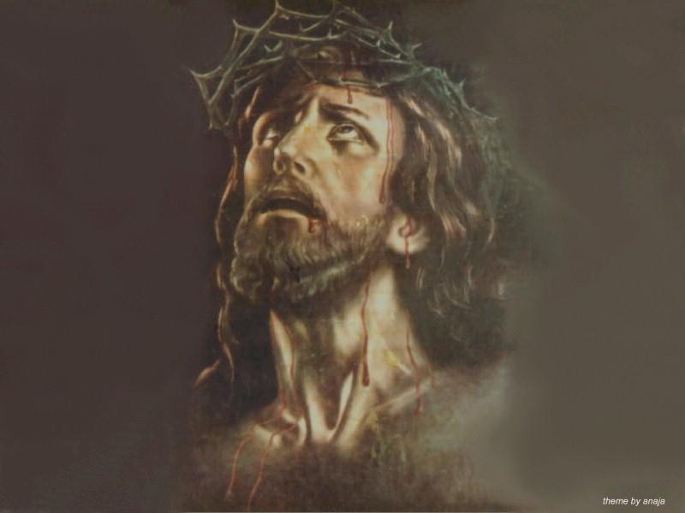
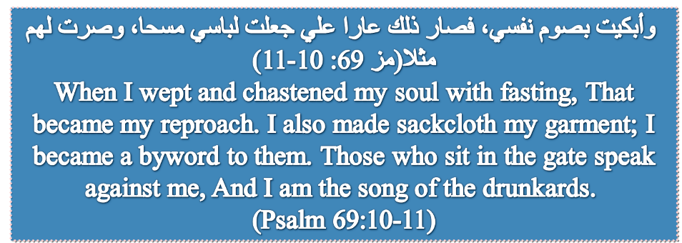

Slide 44
